Slide 1
Contestable Works Consultative Committee

Slide 2
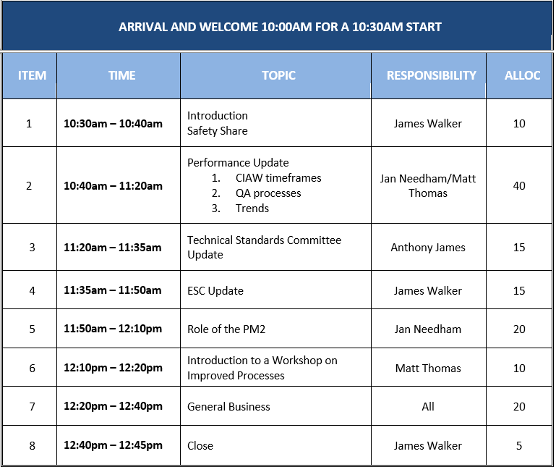
Introduction
Safety share
Attendees
Actions from last meeting
Overview of today
    Performance update
    Communicate progress in key areas
    Introduce process changes and follow up workshop
  Feedback is welcome
Notes:
We have attendees from across industry here today:
Developers
Project Managers
Designers
Electrical contractors
Civil contractors
Auditors
Industry bodies including:
CCF
UDIA
ALDE
ESC
From the Powercor team we have a number of representatives here – I’ll get the team to quickly introduce themselves…

Slide 3
Actions
Action | Responsible | Status
Update ESC on Charter at next meeting scheduled for the 14th July 2019 | Powercor | Closed
Provide further information on cable details inaccuracy audit category | Powercor | Closed Today
Link Bulletins to Technical Standards and provide process clarification | Powercor | In Progress
Powercor will provide an example report showing an overview of all contractor ratings. | Powercor | Closed Today
CCF to provide nominations for Road Contractors to attend the committee | CCF | Open

Slide 4
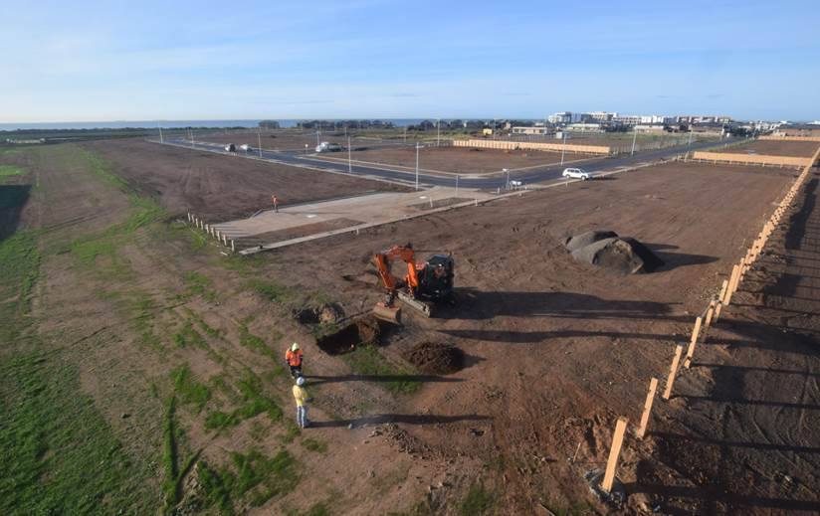
Charter
Improving performance in relation to Contestable Works
Objective
Engage with industry for the purpose of:
Improving the safety on site
Improving the quality of the built asset
Communicating process changes and receiving and incorporating feedback
Improving the understanding and application of technical standards
Providing certainty of timeframes and increasing levels of responsiveness
Agenda
Standard Agenda items are:
ESC overview and update
Contestable Works Team update
Audit Results and Trends
Technical Standards update
Round Table update – ALDE, UDIA, CCF, PM2/Designer, Electrical, Civil
Membership
The membership will consist of representatives from:
Powercor: Design & Customer Programs, Field Audit & Quality, Technical Standards, Network Planning & Development
ALDE, CCF, UDIA
PM2/Designer x 2
Electrical Constructor x 2
Civil Contractor x 2
Frequency
Meetings will occur on a quarterly basis typically:
March
June
September
December
Note: The purpose of the meeting is not to address specific project related issues however working groups can be established as required to resolve industry issues and their outcomes are reported back to the meeting

Slide 5
Audit Performance, Results & Trends

Slide 6
2019 Volumes & timeframes
We are delivering to audit timeframes however re-audits are increasing
Year | No of Projects Audited | Total no of Audits conducted
2018 | 391 | 739
YTD 2019 | 244 | 442

Slide 7
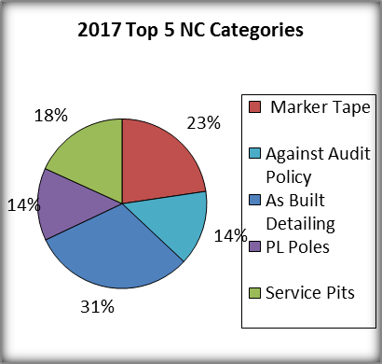
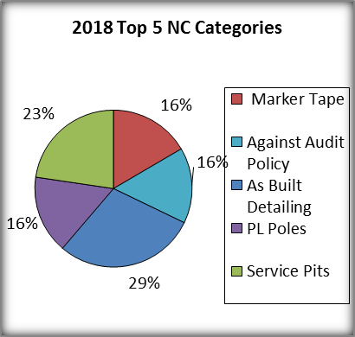
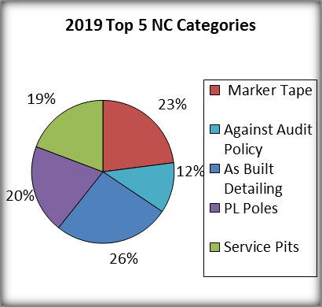
Trends
Similar non-compliances have been identified for the past 3 years and unfortunately the volumes are trending upwards with little sign of improvement
As-Built detailing continues to be an issue – predominantly cable detailing inaccuracies
Service Pits installed too low or not to standard
Marker tape misalignment or not installed
Against Audit Policy (Work not compliant to scope)
2019 projection based on last 8 months Non-Compliance volume (Jan – Aug) - footnote

Slide 8

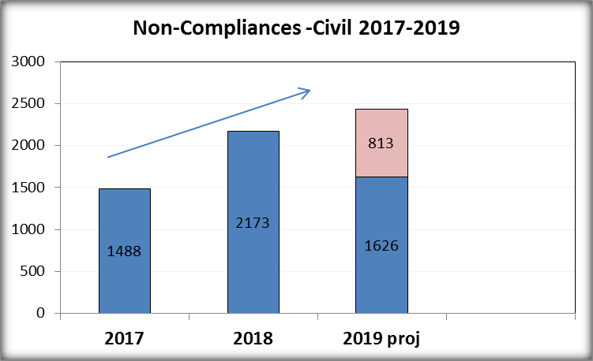
2019 Civil Non-Compliances
The volume of NC’s per project has increased with marker tape still being the biggest issue
Non-compliance details
Top 3 NC’s based on volume
Marker Tape (610)
Service Pits (474)
UG HV conduit clearances (88)
Top 3 Major (-10) NC’s
Marker Tape (199)
Service Pits (53)
Variation to Documentation (18)
2019 projection based on last 8 months Non-Compliance volume (Jan – Aug) - footnote

Slide 9
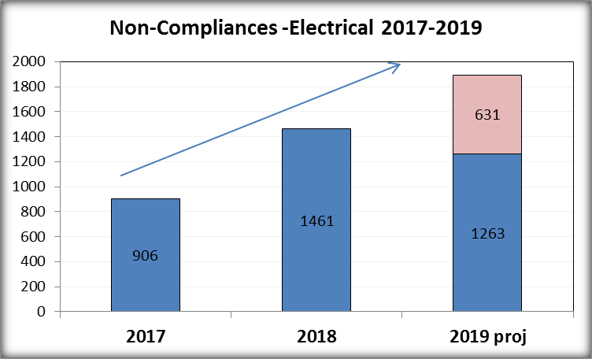
2019 Electrical Non-Compliance
Electrical non-compliances are also on the increase and trending upwards
Non-compliance details
Top 3 NC’s based on volume
PL Poles (503)
Cable Cover Slab Installation (92)
Variation to Documentation (82)
Top 3 Major (-10) NC’s
CHP Cables (22)
Kiosk Sub-Station (14)
Variation to Documentation (11)
2019 projection based on last 8 months Non-Compliance volume (Jan – Aug) - footnote

Slide 10
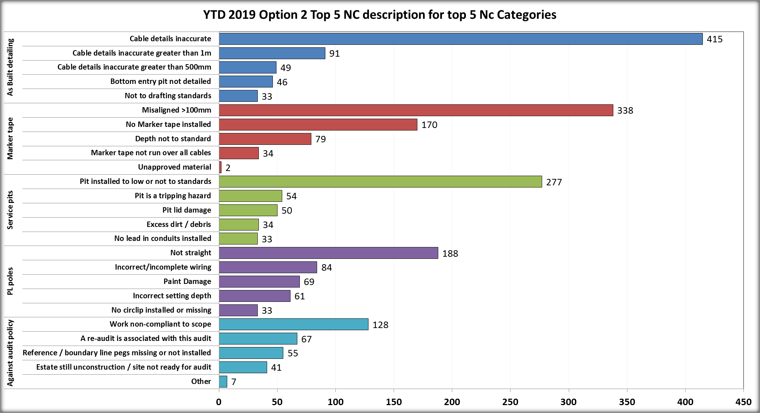
2019 YTD NC Results
Continue to identify inaccurate cable detailing issues and of concern is the volume of no/misaligned marker tape
Minor NC’S

Slide 11
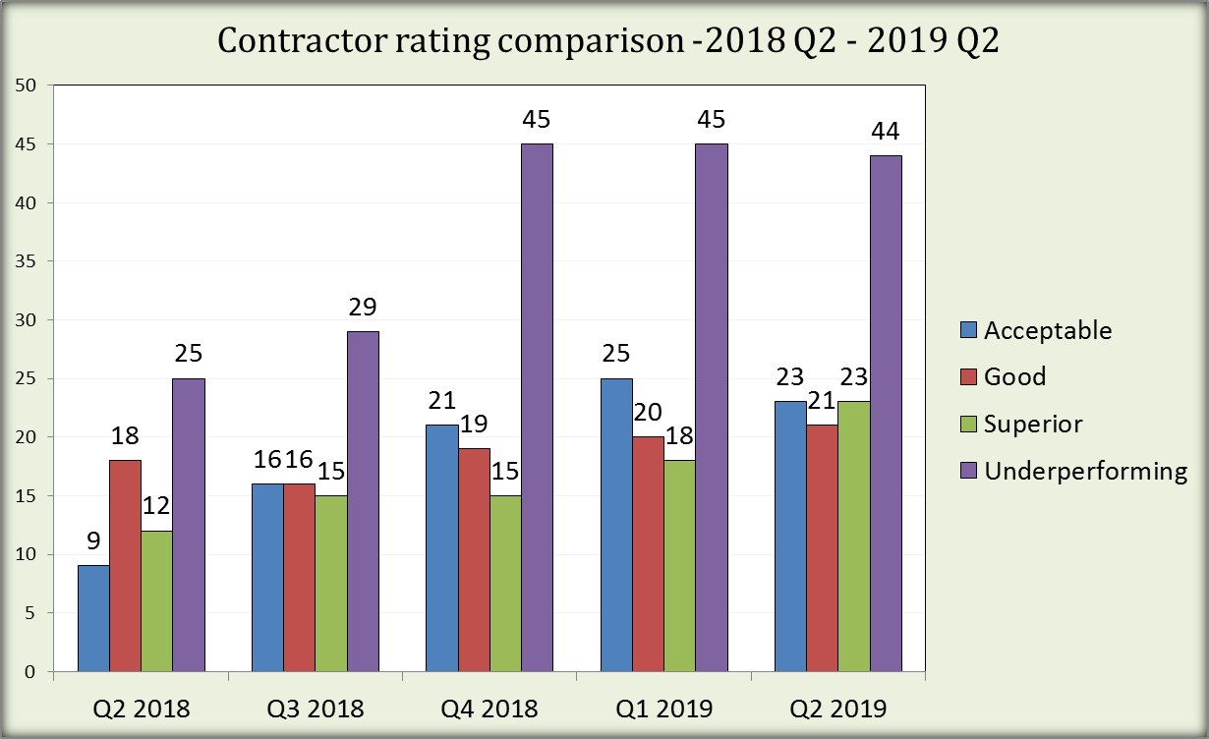
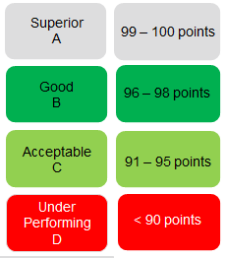
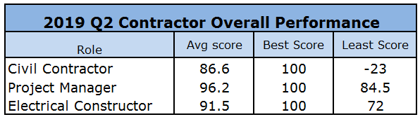
Contractor Rating Comparison
Contractor performance has not improved greatly since the introduction of the Rating System in 2018

Slide 12
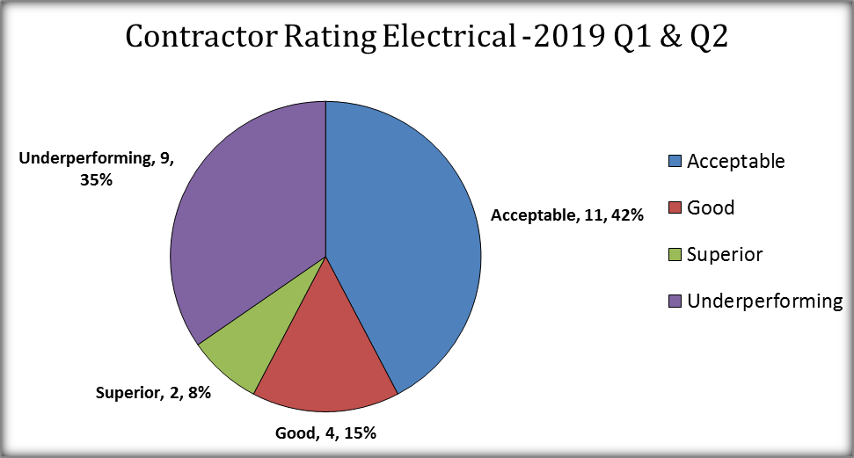
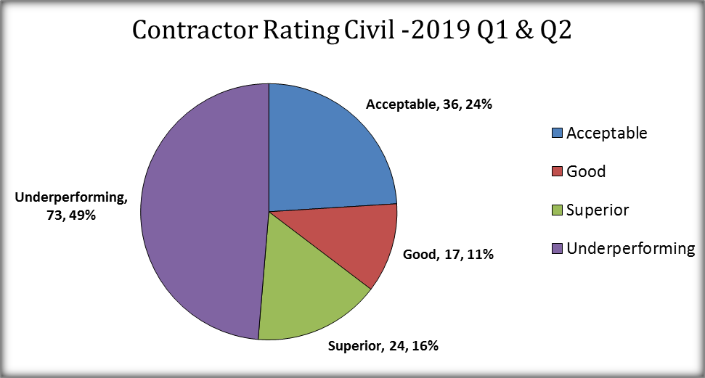
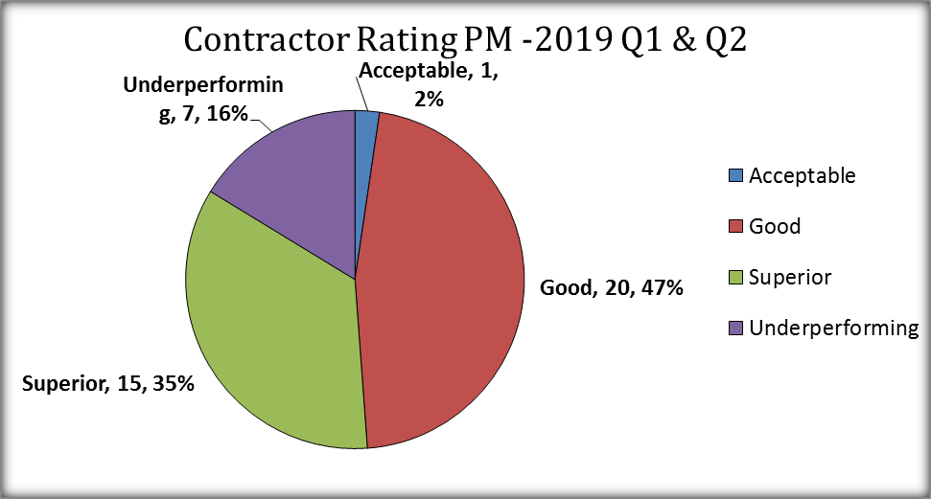
Contractor Ratings – 1H 2019
Large number of contractors are underperforming although we do have a number of Superior rated contractors

Slide 13
Summary
Audit turnaround times from initial audit request to issuing the audit report is < 8 business days
  If projects passed the first audit this would reduce re-audits and result in a quicker turnaround time
Issues still associated with:
  Marker Tape
  Cable detailing inaccuracies
  Service Pits being installed too low
Contractor Ratings
  Civil Contractor Ratings are the lowest since the introduction of the scheme in 2018
  Electrical Contractor Ratings have also declined from Q1 2019
Anecdotally not all companies are performing QA checks prior to requesting final audit which has resulted in:
  Increase in the volume of re-audits
  Increase in non-conformances identified
Powercor expectation is that ALL project have undergone a site inspection including a Quality Control/Assurance check prior to submitting the Final Network Audit Request

Slide 14
Appendices

Slide 15
Update heading
3
Construction
Audit
[insert commentary
Performance
Target
V
Add comments
1. Few projects pass with zero non-conformances, most projects receive an unapproved status and their approval is subject to providing evidence that identified non-conformances have in been fixed. This sometimes happens in real time with the auditor on site or via the contractor providing photographic evidence of the fix at a later date

Slide 16
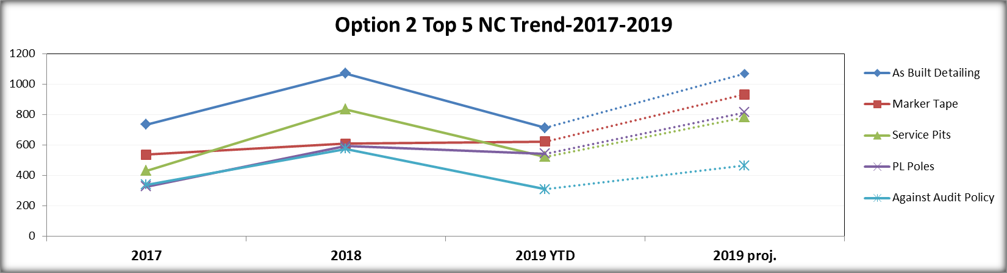

Slide 17
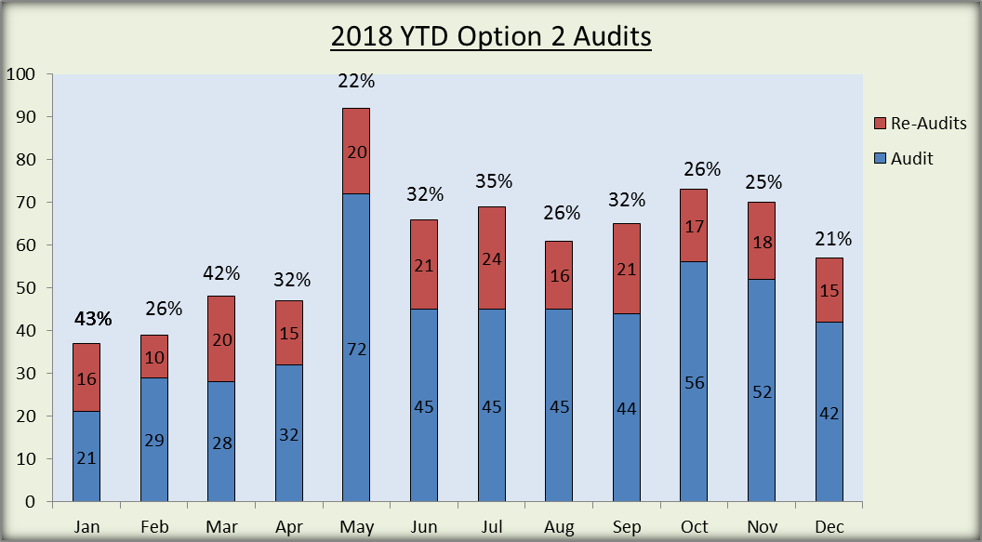
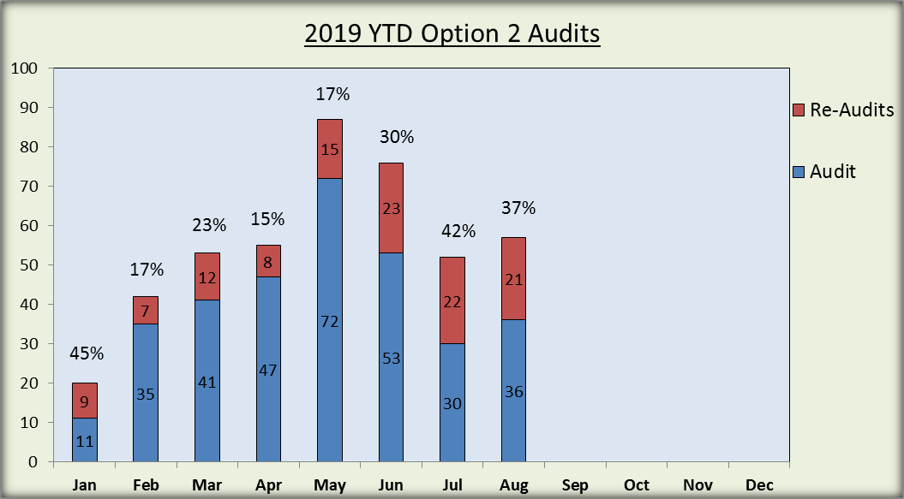
Audit Volumes
We are not seeing an improvement in performance with an increase in the volume of re-audits
Year | No of Projects Audited | Total no of Audits conducted
2018 | 391 | 739
YTD 2019 | 244 | 442

Slide 18
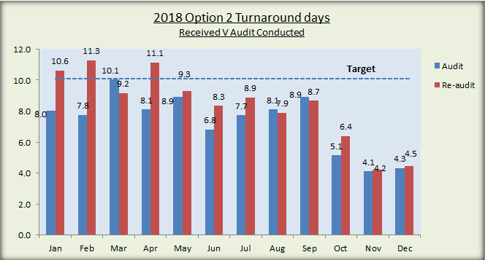
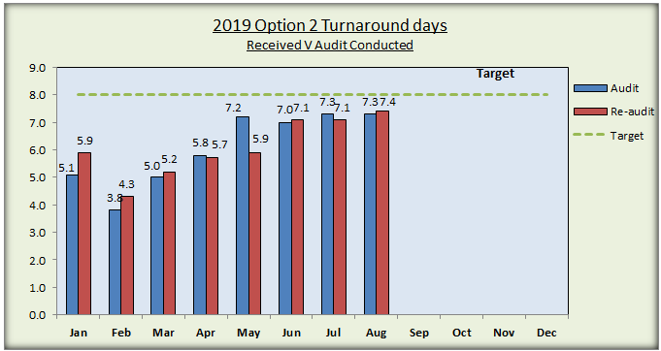
Turnaround Times
We are continuing to meet turnaround time commitments
Audit turnaround times from initial audit request to issuing the audit report is < 8 business days
  2019 First Audit: 10 audits conducted on day 9 & 2 audits conducted on day 10
  2019 Re-Audits: 2 audits conducted on day 11
Turnaround times will reduce for the first final audit if re-audit numbers are reduced
During May and June all auditors were available and additional resources deployed to assist with the forecasted peak
Note: Turnaround times are based on receiving the initial completed audit request, scheduling the audit, conducting the audit and issuing the audit report - footnote

Slide 19
Design QA Processes

Slide 20
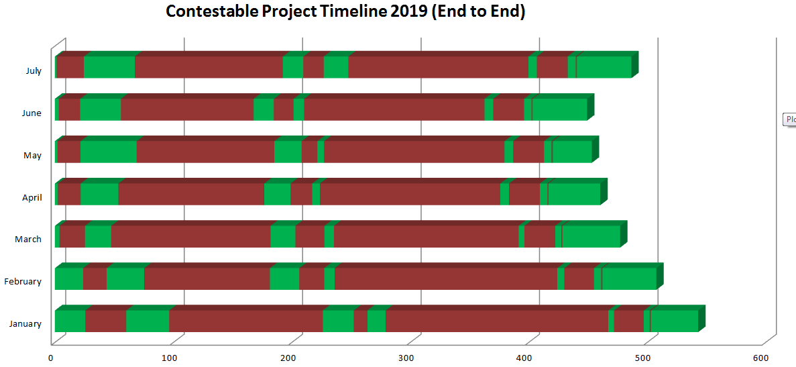
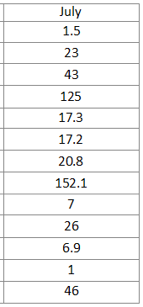
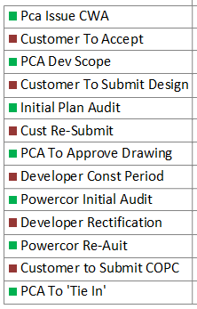
Current Project ‘Turn around Times’

Slide 21
Current performance
48 % of first plan audits are successful.

Slide 22
Recurring issues
Accuracy of connection diagrams continues to be an issue.
Drafting quality has shown improvement.
An increase in trench section errors is a worrying trend.
P/L authorisation was an issue early but is now being addressed.
Environment (trees) shows as an increased issue but in reality was a newish process which wasn’t handled well at first but has improved recently.

Slide 23
ESC Technical Standards Harmonisation
Technical Standards Working Group

Slide 24




Work group members
Anthony James, Technical Standards Manager, CitiPower and Powercor (Lead)
Aza Masoudtehrani, Technical Standards Engineer, CitiPower and Powercor
Saman De Silva, Principle Engineer, Distribution Standards
Jim Tsirikis, Principle Engineer Distribution, United Energy
Max Demko, Senior Engineer, Jemena

Slide 25
Scope of Technical Standards Harmonisation
Review the civil URD (urban residential development) design and construction standards across all five Victorian Distribution Businesses and where possible align key design and construction parameters across the Victorian Distribution Businesses.
The criteria for alignment will be based on:
Compliance to government regulations and Australian Standards
Least cost, technically acceptable solutions
Constructability
Ease of use and understanding of the standards
In addition to the harmonisation activity the following areas of the standards will also be reviewed¹:
CitiPower/Powercor’s² type 1 & 2 kiosk easements would be reviewed, with the intention of only using type 2 kiosk easements for URDs. This would align with the other distribution businesses.
The potential to install HV cables into conduits for future stages. That is, cables will be capped and then jointed into the future stage.
¹ As agreed at the Technical Standards Working Group and Construction meeting held on the 5th of July
² This change only impacts CitiPower/Powercor kiosk reserves, proposed change will align with other DBs
Decision required:
Endorse project scope

Slide 26
Deliverables
Gap analysis report outlining difference and commonalities between all five Victorian Distribution Business standards related to URDs
Harmonisation report outlining key design and construction parameters for alignment
Implementation plan & communication strategy for each DB
Implementation of agreed changes to Technical Standards
Decision required:
Endorse deliverables

Slide 27

Activities
Completed activities
Established Technical Standards working group
Determined relevant URD standards across all five DBs
Developed gap analysis scope for quotation
Obtained quotes from consultants
Evaluating quotes from consultants and appointment of successful consultant
In progress activity
Gap analysis report
13/09/2019

Slide 28
Proposed timeline
Technical Standards Steering Committee meeting
Technical Standards Steering Committee meeting
IN PROGRESS
12 July 2019
13 September 2019
25 September 2019
11 October 2019
1 November 2019
22 November 2019
12 December 2019
Appoint consultant
Complete gap analysis
Gap analysis finding update
Review gap analysis and agree on harmonisation opportunities
Review and endorse harmonisation opportunities
(via circulation)
Develop implementation plan & communication strategy
Review, comment and endorse the implementation & communication strategy
Technical Standards Steering Committee
Technical Standards Steering Committee
Technical Standards Working Group
Consultant
Technical Standards Working Group
Technical Standards Steering Committee
Technical Standards Working Group
Technical Standards Steering Committee meeting
Technical Standards Steering Committee meeting
End of Feb 2020
Q1 2020
(TBC) ¹
End of May 2020
Progress update
Technical Standards published & communicated
Feedback from Technical Standards Steering Committee regarding updated standards
Decision required:
Endorse proposed timeline
Technical Standards Steering Committee
Technical Standards Steering Committee
Technical Standards Working Group
¹Date to be confirmed following completion of 22 November milestone

Slide 29
ESC Update
1H 2019

Slide 30
The Essential Services Commission (ESC) Service Improvement Commitments (SIC)
Service Improvement Commitments
Improve developers and contractors understanding of distribution business’ policies and practises, or how they can influence them
Minimising avoidable delays in connecting greenfield developments to existing distribution networks
Improving how technical standards are managed and communicated
Improve audit processes and practises
Promoting efficient competition in connection services (or component parts)
Resource constraints – evidence that resourcing is sufficiently aligned to increased residential development activities
Performance Commitments
Master Plan and Stage Scopes
Design Approvals
‘As-built’ Construction Audit
Grant Practical Completion
Construction ‘tie-in’
Change process to allow Developer to submit Master Plan and Stage Scopes to Powercor for review/ approval
Complete audit of design plan in less than 20 business days
Undertake construction audit within 5 to 8 business days of compliant audit request
Grant Practical Completion in less than 10 business days
New Process – offer option of ‘tie-in’ within
20 business days from achieving practical completion

Slide 31
ESC Governance meeting #5 was held in early July
ESC outcome sought
Status
Highlights
1
Improving developers and contractors understanding of the distribution business’ policies and practices and how they can influence them
On track
Established Technical Standards Harmonisation Committee
Held first Technical Standards Harmonisation Committee meeting and engaged consultant to undertake ‘gap’ analysis
Commenced development of an IT portal to assist stakeholders track progress of their project (go-live expected later this year)
Developed 2 new processes that will be subject of follow up workshops
  Master Plan review
  20 day construction tie-in
Tabled a detailed report of our performance against 5 key stages of Option 2 development
2
Minimising avoidable delays in connecting greenfield developments to the existing distribution network
On track
3
Improving how technical standards are managed and communicated
ON track
4
Reviewing and improving audit processes
On track
5
Promoting efficient competition in connection services
Completed
6
Resource constraints – evidence that resourcing is sufficiently aligned to increased residential development activities
On track

Slide 32
Powercor has committed to improving in 5 key stages of the connection process
Stage
Target
1H19 Performance¹
1
Master
plan review
Replace staged scopes with a Master Plan review process – target to complete Master Plan reviews in 10 business days
New process 16.0 days²
Old process 34.0 days
2
Design
review
Target completion of design plan audits and re-audits within 20 business days
18.4 days
3
Construction
audit
Complete construction audit (from request to final report) within 5 to 8 business days
6.1 days
4
Practical completion
Grant practical completion in less than 10 business days from request
2.3 days
5
Construction ‘tie-in’
Meet customer dates and implement new process to offer the option of a 20-business day construction tie in
New process being implemented
90% customer target date met in June
All performance measures are in business days
New process is in trial and we only have a small sample size. We expect to roll the new process out in 2H2019

Slide 33
Role of the PM2

Slide 34
Overview & Proposal
Overview
Following discussions from the last industry forum a working group was to be formed to determine the role of the PM2
In some instances not all PM2’s are across all activities on an Option 2 project and greater clarity around the responsibilities were required
This includes being the key contact between Powercor and the Developer
Proposal
Developer appoints and nominates one person/organisation who is accountable and responsible for their project. This role will oversee the construction and project manage all aspects of the Option 2 project and they will be nominated on the tender document
Responsibilities include:
    Conduit/one point of contact between Powercor and the Developer
    Co-ordinate construction activities on-site
    Submits all relevant documentation
    Responsible for rectification of audit non-compliances on site including re-audit invoice payments

Slide 35
Workshop Introductions

Slide 36
Process improvement focus areas
Developer application
Timelines based on projects that were completed in 1H2019 which took an average of ~421 business days from Application to SOC¹
Consent for SOC
Application response | Customer acceptance | Scope Development | Design plan development | Design Plan Audit | Construction | Construction Audit | Practical Completion | Construction Tie-in
Powercor | Developer | Powercor | Developer | Powercor | Developer | Powercor | Powercor | Powercor
10.3 | 22.1 | 34.0 | 137.8 | 18.4 | 190.5 | 6.1 | 2.3 | 42.8
Master plan review
Design review & Safety in Design
Tie in process
IT Systems
SOC = Statement of compliance

Slide 37
Upcoming: Process improvement workshop
Electric House, 40 Market St. Tuesday 8th October, 9am-1pm
Topics to be covered
    Tie in process
    Master Plan Review
    Design review and Safety in Design
    IT systems
Who should attend.
Everybody welcome, however we are targeting engagement with:
    PM2’s
    Design houses

