Slide 1
Contestable Works Consultative Committee

Slide 2
Audit Performance, Results & Trends

Slide 3
2019 Volumes & timeframes We are delivering to audit timeframes however re-audits are increasing
Year | No of Projects Audited | Total no of Audits conducted
2018 | 391 | 739
YTD 2019 | 244 | 442

Slide 4
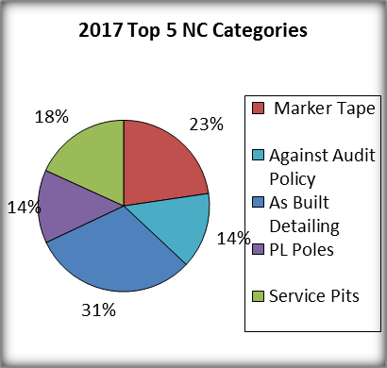
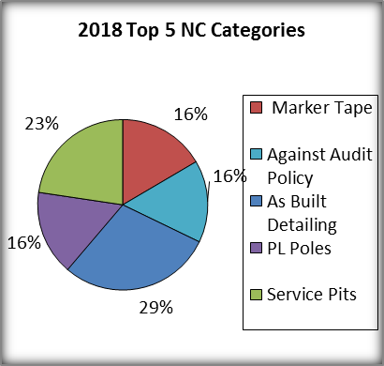
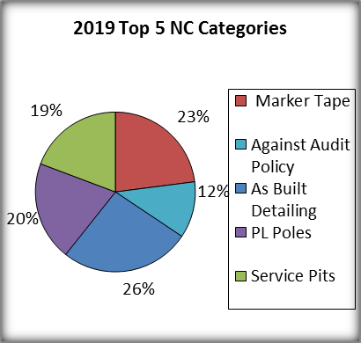
Trends Similar non-compliances have been identified for the past 3 years and unfortunately the volumes are trending upwards with little sign of improvement
As-Built detailing continues to be an issue – predominantly cable detailing inaccuracies
Service Pits installed too low or not to standard
Marker tape misalignment or not installed
Against Audit Policy (Work not compliant to scope)
2019 projection based on last 8 months Non-Compliance volume (Jan – Aug) - footnote

Slide 5
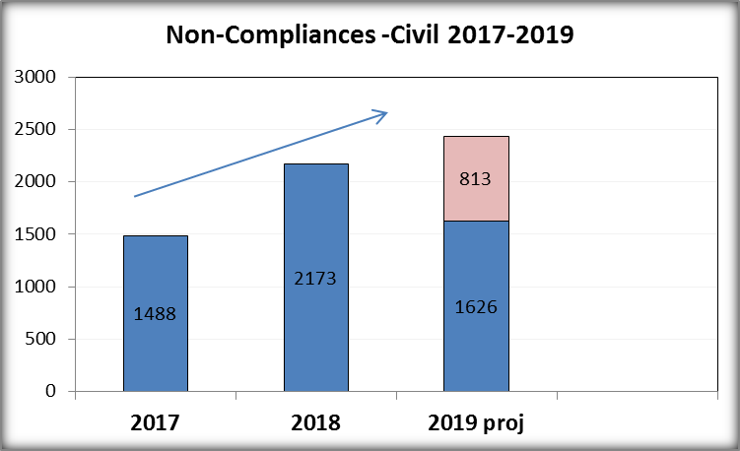
2019 Civil Non-Compliances The volume of NC’s per project has increased with marker tape still being the biggest issue
Non-compliance details
Top 3 NC’s based on volume
Marker Tape (610)
Service Pits (474)
UG HV conduit clearances (88)
Top 3 Major (-10) NC’s
Marker Tape (199)
Service Pits (53)
Variation to Documentation (18)
2019 projection based on last 8 months Non-Compliance volume (Jan – Aug) - footnote

Slide 6
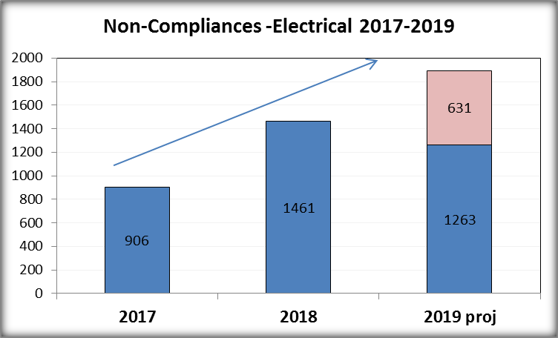
2019 Electrical Non-Compliance Electrical non-compliances are also on the increase and trending upwards
Non-compliance details
Top 3 NC’s based on volume
PL Poles (503)
Cable Cover Slab Installation (92)
Variation to Documentation (82)
Top 3 Major (-10) NC’s
CHP Cables (22)
Kiosk Sub-Station (14)
Variation to Documentation (11)
2019 projection based on last 8 months Non-Compliance volume (Jan – Aug) - footnote

Slide 7
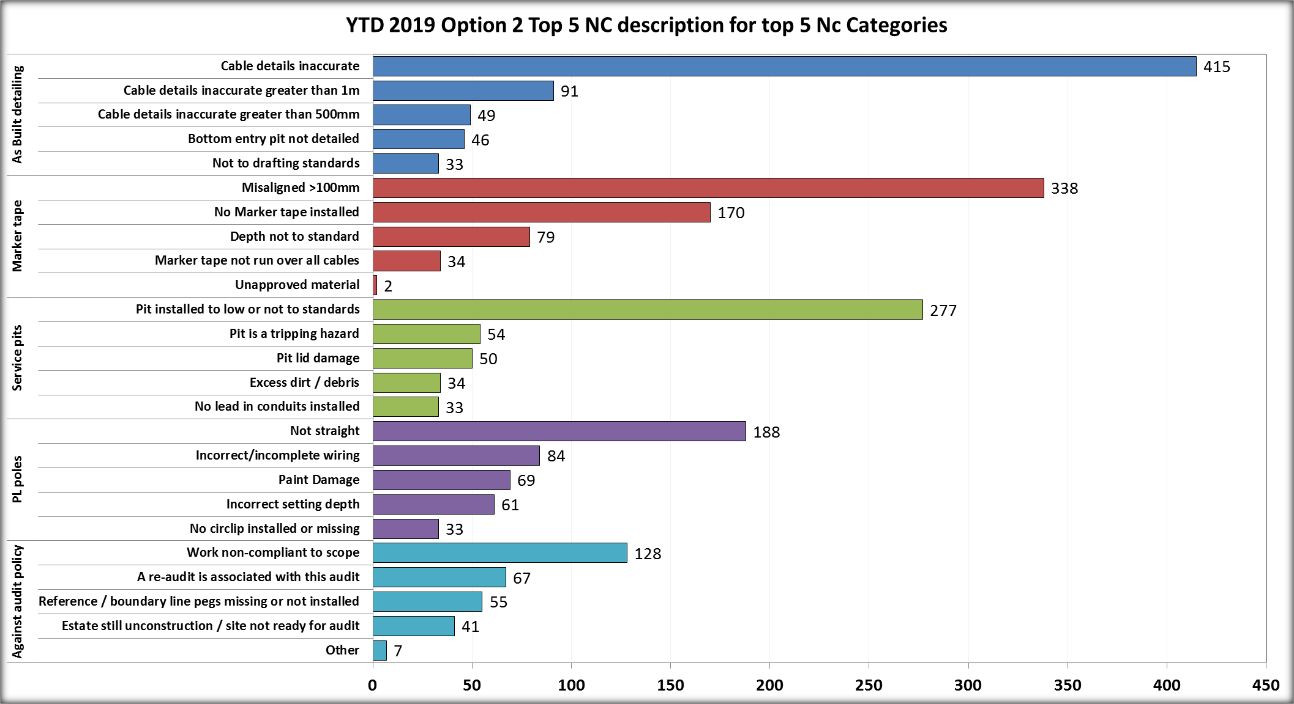
2019 YTD NC Results Continue to identify inaccurate cable detailing issues and of concern is the volume of no/misaligned marker tape
Minor NC’S

Slide 8
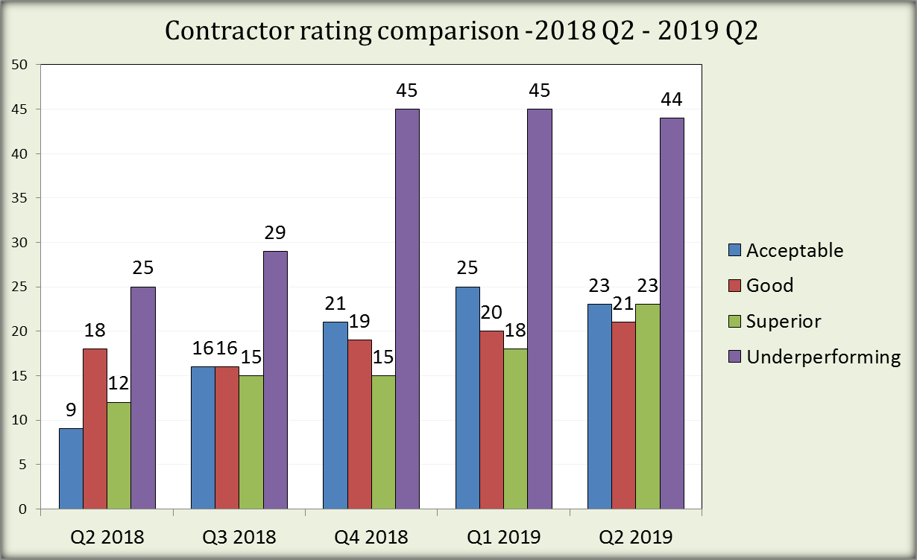
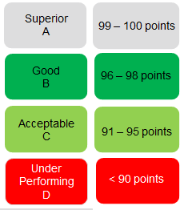
Contractor Rating Comparison Contractor performance has not improved greatly since the introduction of the Rating System in 2018

Slide 9
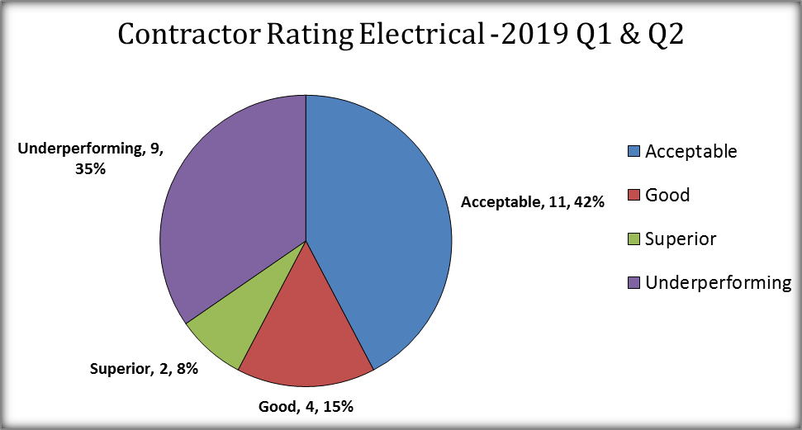
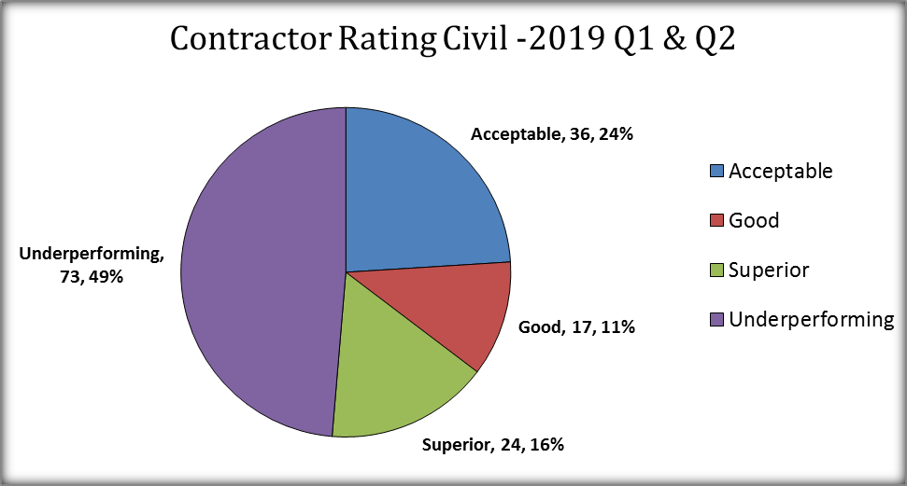
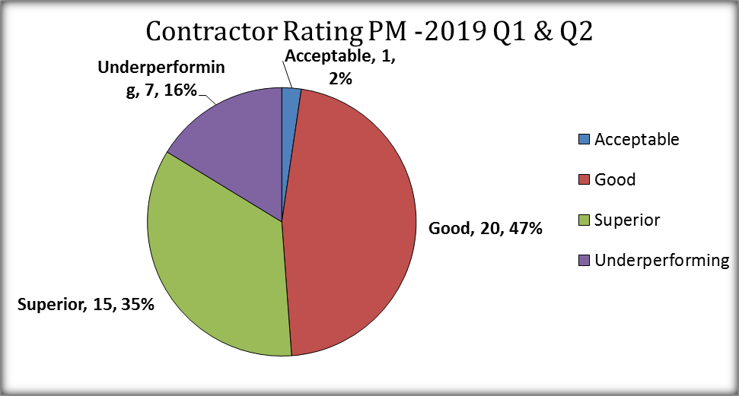
Contractor Ratings – 1H 2019 Large number of contractors are underperforming although we do have a number of Superior rated contractors

Slide 10
Summary
Audit turnaround times from initial audit request to issuing the audit report is < 8 business days
If projects passed the first audit this would reduce re-audits and result in a quicker turnaround time
Issues still associated with:
Marker Tape
Cable detailing inaccuracies
Service Pits being installed too low
Contractor Ratings
Civil Contractor Ratings are the lowest since the introduction of the scheme in 2018
Electrical Contractor Ratings have also declined from Q1 2019
Anecdotally not all companies are performing QA checks prior to requesting final audit which has resulted in:
Increase in the volume of re-audits
Increase in non-conformances identified
Powercor expectation is that ALL project have undergone a site inspection including a Quality Control/Assurance check prior to submitting the Final Network Audit Request

Slide 11
Appendices

Slide 12
Update heading
3
Construction
Audit
[insert commentary
Performance
Target
V
Add comments
1. Few projects pass with zero non-conformances, most projects receive an unapproved status and their approval is subject to providing evidence that identified non-conformances have in been fixed. This sometimes happens in real time with the auditor on site or via the contractor providing photographic evidence of the fix at a later date

Slide 14
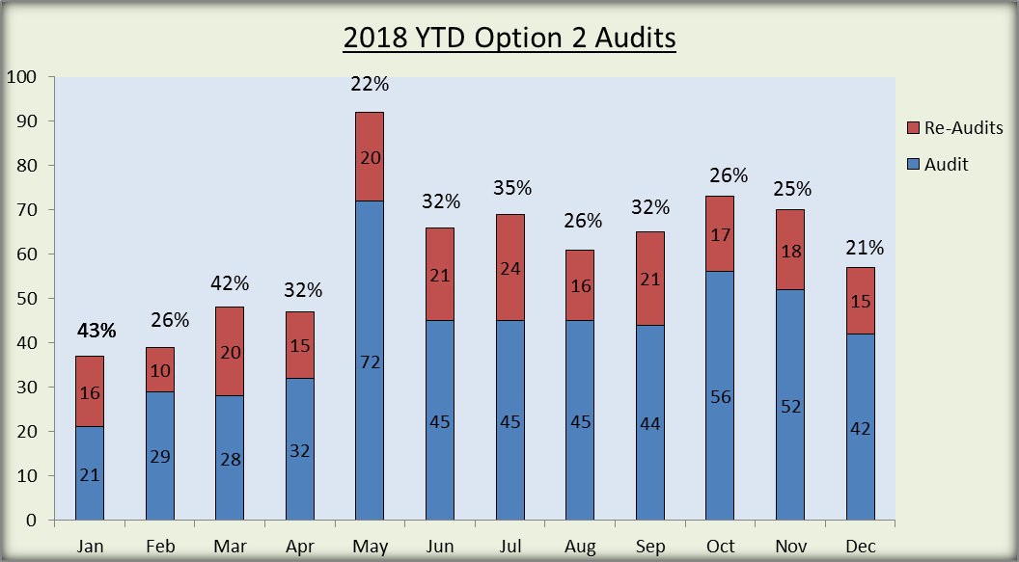
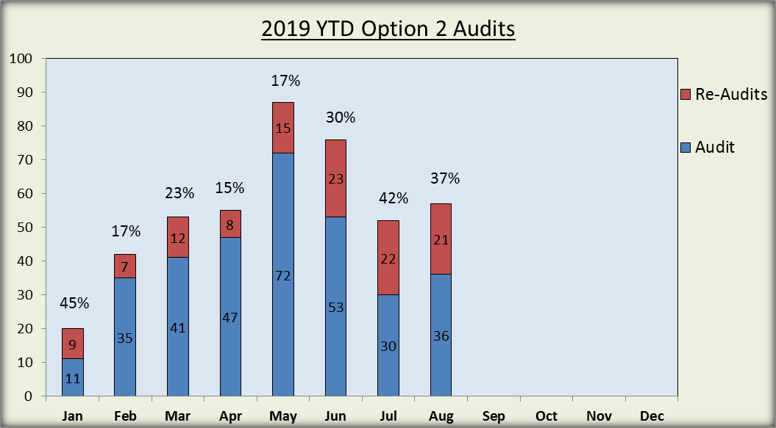
Audit Volumes We are not seeing an improvement in performance with an increase in the volume of re-audits
Year | No of Projects Audited | Total no of Audits conducted
2018 | 391 | 739
YTD 2019 | 244 | 442

Slide 15
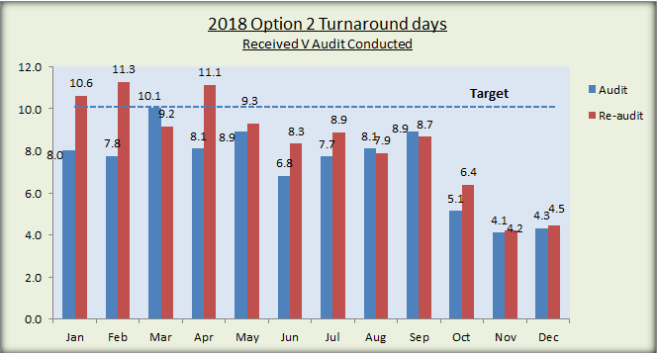
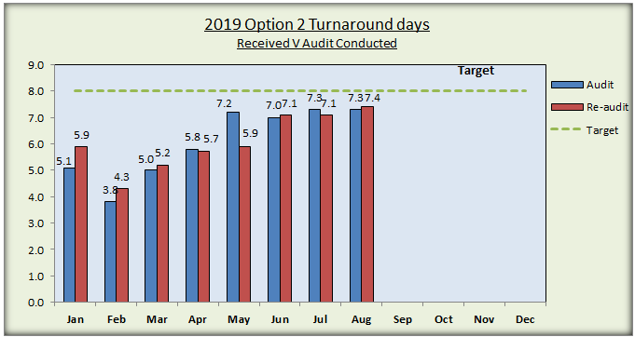
Turnaround Times We are continuing to meet turnaround time commitments
Audit turnaround times from initial audit request to issuing the audit report is < 8 business days
2019 First Audit: 10 audits conducted on day 9 & 2 audits conducted on day 10
2019 Re-Audits: 2 audits conducted on day 11
Turnaround times will reduce for the first final audit if re-audit numbers are reduced
During May and June all auditors were available and additional resources deployed to assist with the forecasted peak
Note: Turnaround times are based on receiving the initial completed audit request, scheduling the audit, conducting the audit and issuing the audit report - footnote

Slide 16
Design QA Processes

Slide 17
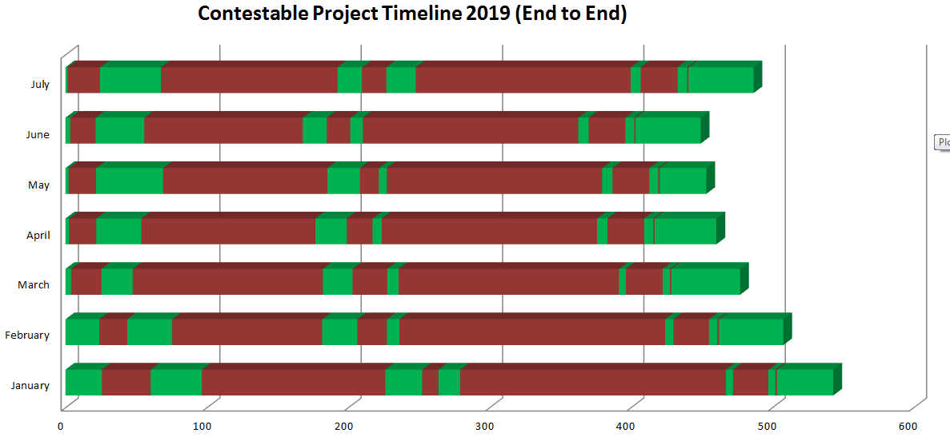
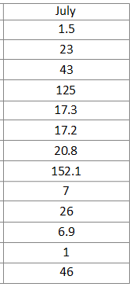
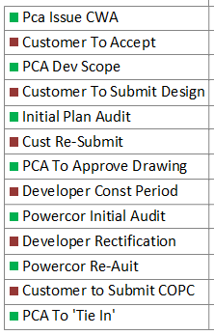
Current Project ‘Turn around Times’

Slide 18
Current performance 48 % of first plan audits are successful.

Slide 19
Recurring issues
Accuracy of connection diagrams continues to be an issue.
Drafting quality has shown improvement.
An increase in trench section errors is a worrying trend.
P/L authorisation was an issue early but is now being addressed.
Environment (trees) shows as an increased issue but in reality was a newish process which wasn’t handled well at first but has improved recently.

